Slide 1
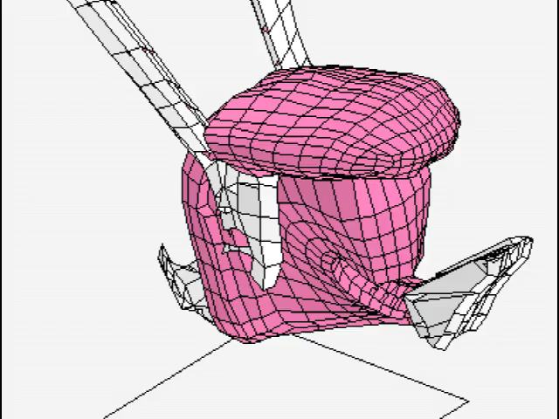
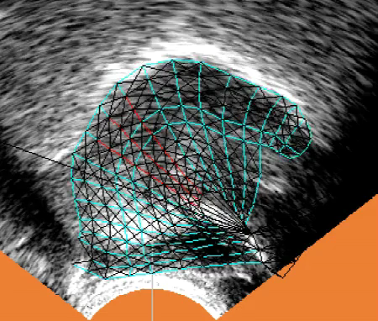
A MASSLESS 3D BIOMECHANICAL MODEL OF THE TONGUE AND ITS RELATION TO THE λ MODEL
Alan Wrench^{1, 2}, Peter Balch 1 Articulate Instruments Ltd UK 2 Queen Margaret University, UK
Notes:
We have built and continue to develop an interactive 3D sketchpad for building biomechanical models; for modifying and testing the properties of these structures.

Slide 2
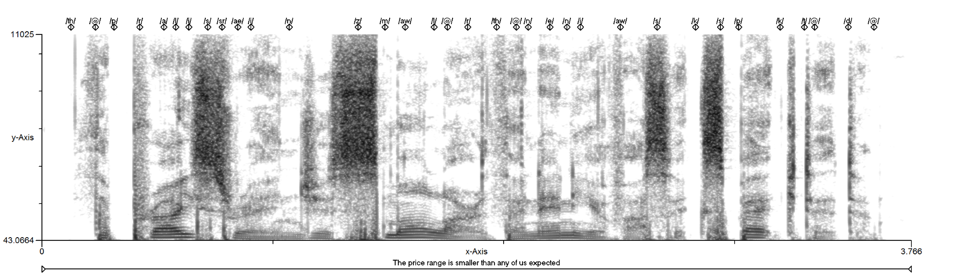
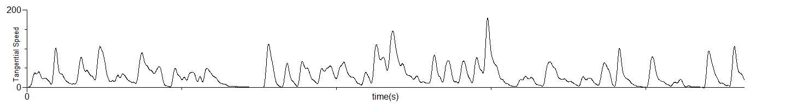
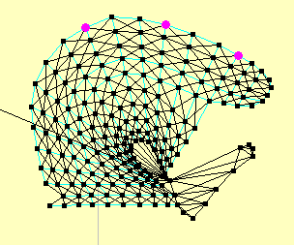
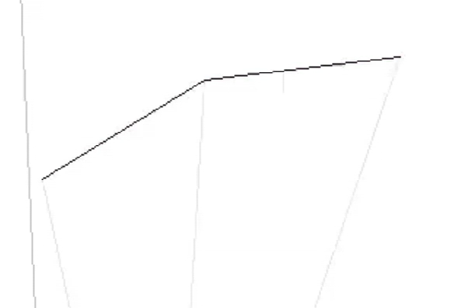
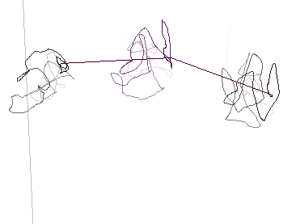
Virtual tongue tip sensor tangential velocity
Virtual EMA sensors
Virtual EMA sensor path for whole recording

Slide 3
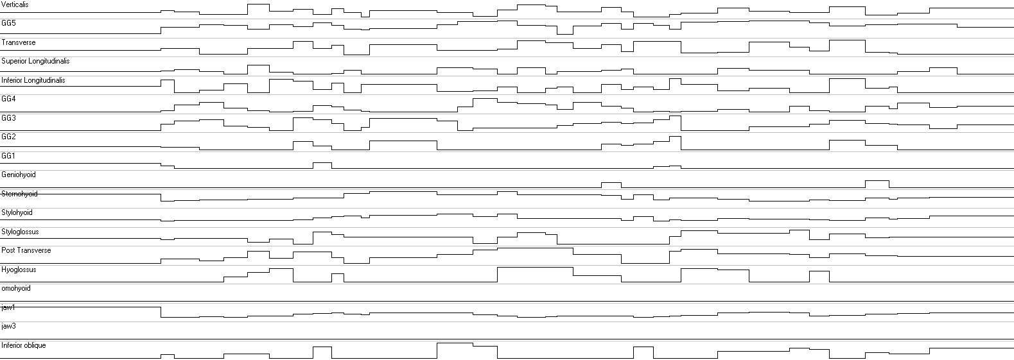
That tongue movement was created by discrete muscle commands at 35 instants.
The fluidity arises from motoneuron behaviour and the resultant gradual movement towards a new equilibrium target position in response to those discrete commands

Slide 4
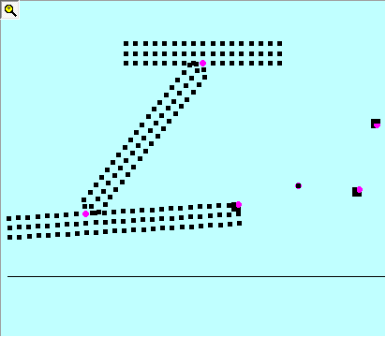
Overview (dynamic control of the model)
We have implemented a feedforward equilibrium model of motor control based on neurophysiology
(we have not yet attempted to model learning or adaptation)
For this presentation we have constructed a very simple arm to demonstrate the model dynamics.
scapula
A
humerous
C
B
radius&ulna
D
Notes:
Apologies for the dry title. In true academic tradition I wrote the abstract before I did most of the work I’m about to present so although I’ll be describing the dynamics of our model I’ve only got one slide comparing it to Feldman’s lambda model.

Slide 5
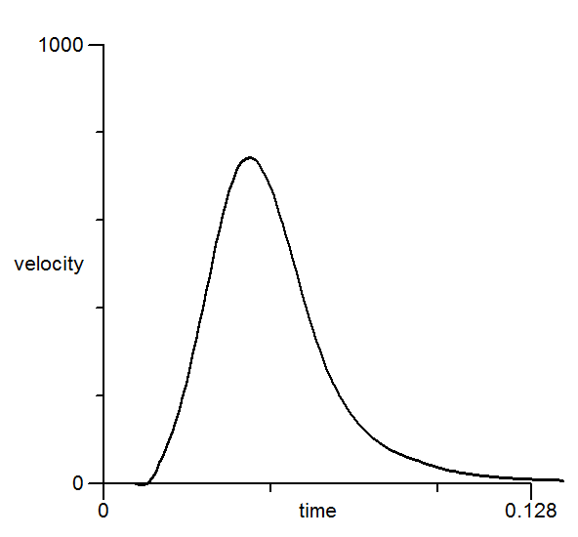
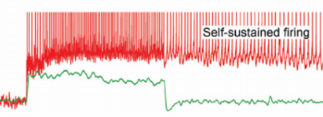
A (grossly) simplified motoneuronal flow chart Given a Central Nervous system (CNS) command, a group of competing (antagonistic) muscles self regulate to reach equilibrium
Central Nervous System
Discrete pulses to each muscle
Motor command
Self sustained firing
Motor neurons
Motor neurons
Motor neurons
Motor neurons
Muscle 1
Muscle 2
Muscle 3
Muscle 4
The process of reaching equilibrium takes time
( 10s of milliseconds)
Fluid movement
Velocity of articulated movement

Slide 6
The force applied to a node is dependent on the difference between the current length (l) of the muscle and the length it should be (λ) given the muscle activation F = function (l - λ)
How does our 3D mesh structure model this?
< f1 >
< f2 >
Time t
free node
< f3 >
fixed node
actual muscle fibre length (l)
Time t+T
desired muscle fibre length (λ)
NB Nodes and fibres are massless so in our model there is no Force = mass x acceleration
This force is assumed negligible for our purposes.
Time t+T
We use Newton Raphson iteration to find a solution where all the forces cancel each other out i.e. equilibrium

Slide 7
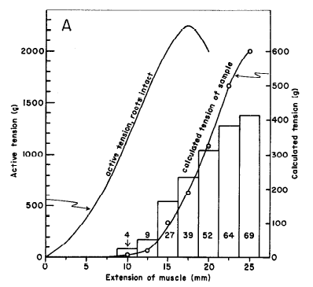

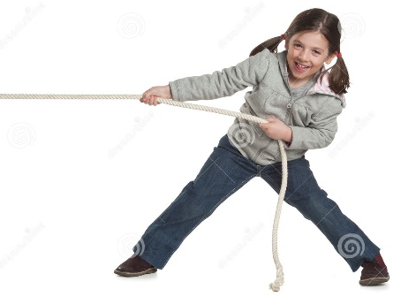
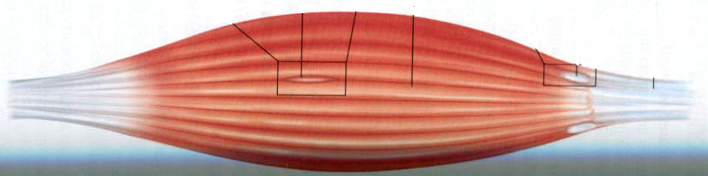
What force function should be used?
Henneman principle motor neuron recruitment (Henneman 1965)
As a muscle is stretched ( i.e. as l- λ increases), larger motor units are recruited and the force opposing the stretch increases.
A range of differently sized alpha motor neurons control each muscle
Larger alpha motor neurons have higher thresholds and are in charge of larger pools of muscle filaments.
More filaments in a pool means that pool exerts more force

Slide 8
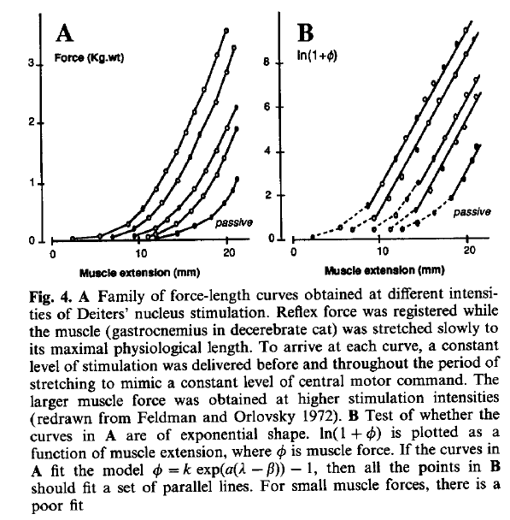
The stretch reflex
For a given desired muscle length (λ) the force is zero.
The force rises as the muscle is stretched to a longer length.
Mathews 1959 and Feldman & Orlovsky 1972
4.5V pulse stimulation
2V pulse stimulation
λ=2cm
λ =9cm
Active rest length at 4.5V pulse stimulation
Active rest length at 2V pulse stimulation
Force-length curves for different voltages (0V,2V,3V,4.5V) of 70Hz square wave (0.1ms pulse duration) of the cerebellar nucleus (cat) i.e. different levels of motor command activity. (Feldman and Orlovsky,1972)
Passive rest length with no stimulation

Slide 9

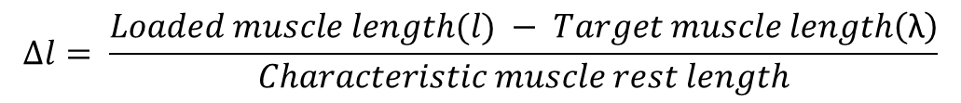
Modelling the tonic stretch reflex (Our current force formula)
$$F=k∗({∆l)}^{2}$$
$$∆l= \frac{Loaded muscle length(l) − Target muscle length\left(\text{λ}\right)}{Characteristic muscle rest length}$$

Slide 10
So how does this equilibrium model behave?
We need a simple biomechanical example to show the properties.

Slide 11
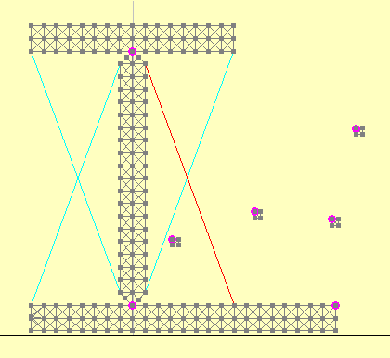
Simple arm model
A
C
B
RIGID “Bones” with
fixed pivots
D
1
2
A
4 single muscle elements
B
D
= virtual EMA sensor
4
3
C
4 positional Targets
“Hand”

Slide 12
Simple arm model
A
1 “Deltoid”
2 “Pectoralis”
3 “Triceps” 4 “Biceps”
C
B
D
1
α
2
A
1 & 2 control shoulder angle α
3 & 4 control elbow angle β
B
D
= virtual EMA sensor
4
3
C
β

Slide 13
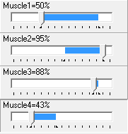
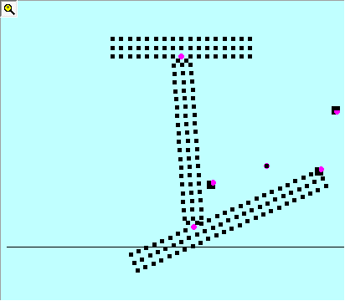
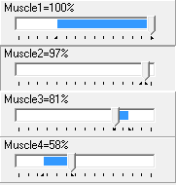
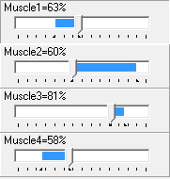
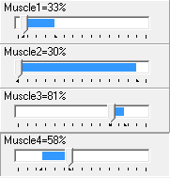
Relative λ commands to antagonistic muscles determines position.
λ levels expressed as % of rest length
A
1 “Deltoid”
2 “Pectoralis”
3 “Triceps”
4 “Biceps”
B
C
D
Maintaining relative λ levels but increasing absolute λ levels increases stiffness but does not change position.
A
1 “Deltoid”
2 “Pectoralis”
3 “Triceps”
4 “Biceps”
B
C
D

Slide 14
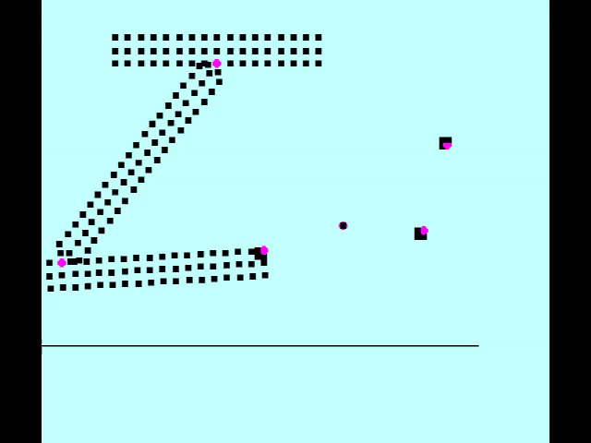
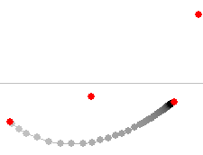
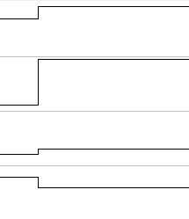
C
D
A
A
B
B
C
D
C
D
1.8s
Del
Pec
Tri
Bi

Slide 15
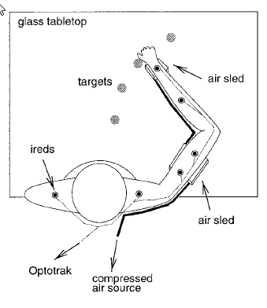
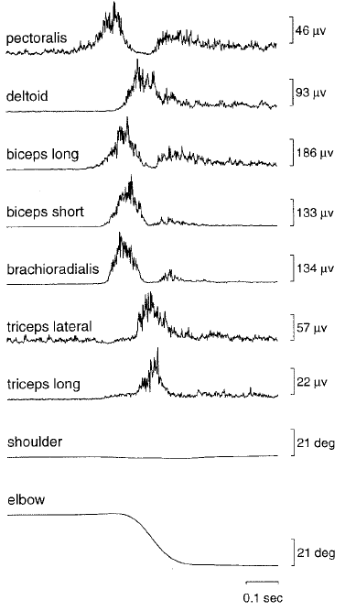
Muscles are not activated at the same time. They are staggered.
For this movement the staging is ordered:
1st Pectoralis
2nd Biceps
3rd Deltoid
4th Triceps
EMG signals corresponding to an elbow movement
Gribble & Ostry 1999

Slide 16
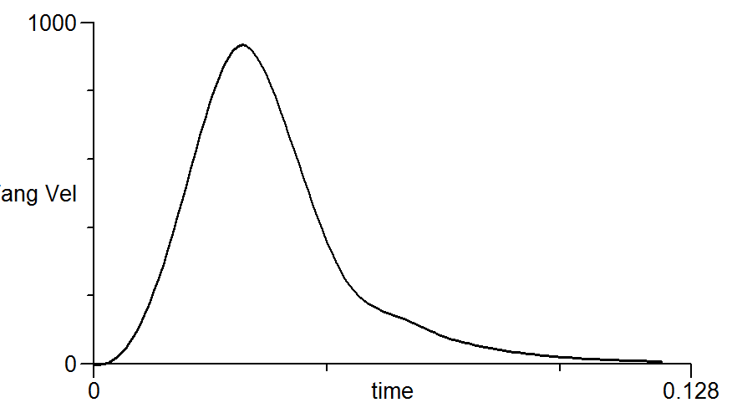
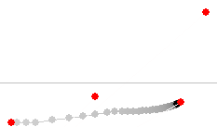
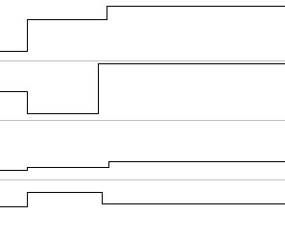
1.8s
A
A
B
C
D
B
1.8s
C
D
Del
Pec
Tri
Bi
NOTE: The absolute values (co-contraction) of antagonist muscles DO make a difference to the trajectory because they are initiated different timed stages.

Slide 17
Often we see these second smaller EMG peaks
EMG signals corresponding to an elbow movement
Gribble & Ostry 1999

Slide 18
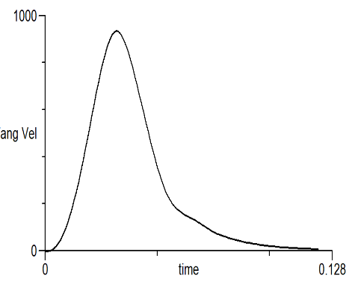
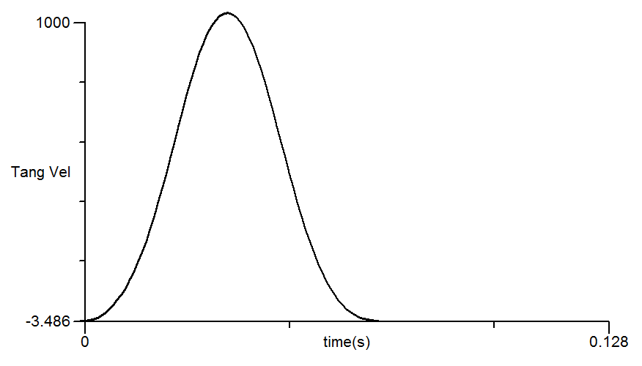
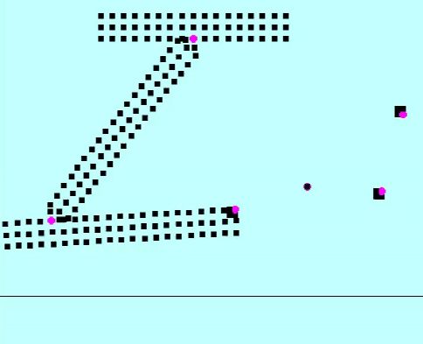
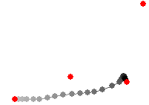
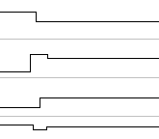
1.8s
1.8s
A
A
B
B
+
C
D
C
D
1.8s
Del
Pec
Tri
Bi
Aim beyond target then change to actual target just before the target is reached

Slide 19
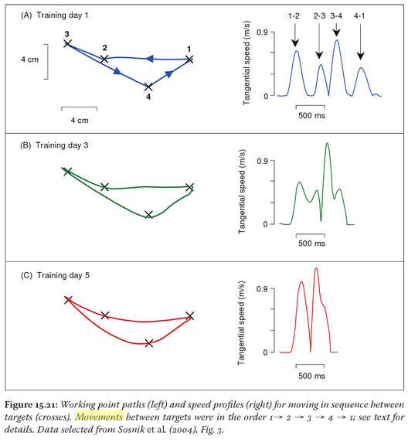
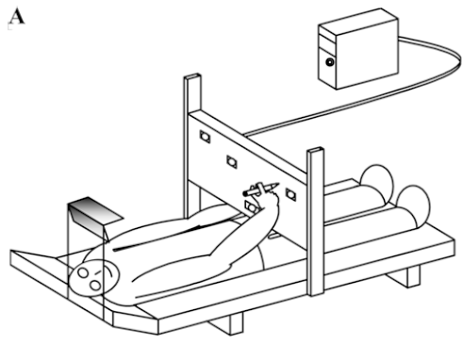
A simple co-articulation experiment (Sosnik et al 2004)
Training Day 1
A-B B-C C-D D-A
C
B
A
D
Training Day 3
C
B
A
D
Training Day 5
C
B
A
Join the crosses as quickly and accurately as possible
D

Slide 20
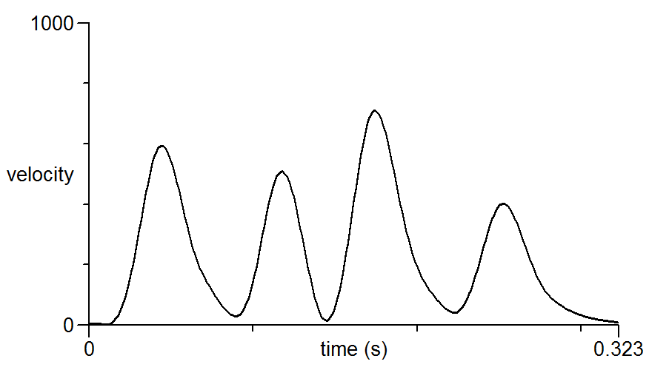
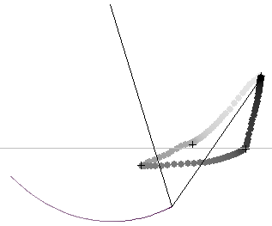
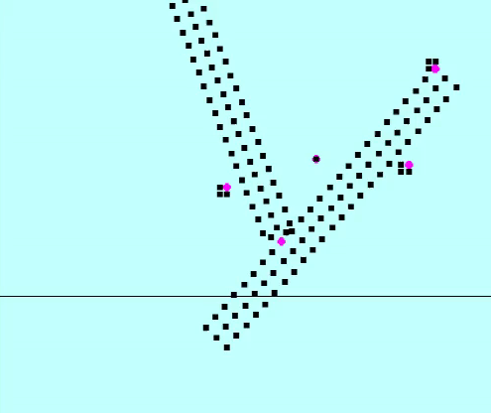
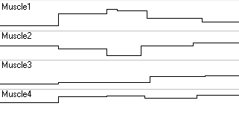
4 target positions with staged muscle commands to keep paths straight. Also strategy of aiming beyond target and then a second command to adjust back to target before the target is reached used in stage B-C.
A-B B-C C-D D-A
A
A
B
B
C
D
C
D
5.4s
Del
Pec
Tri
Bi

Slide 21
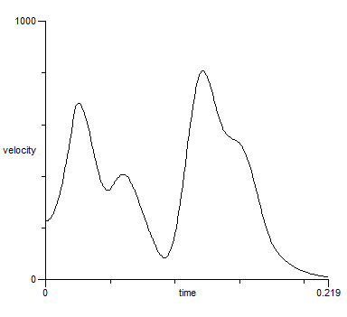
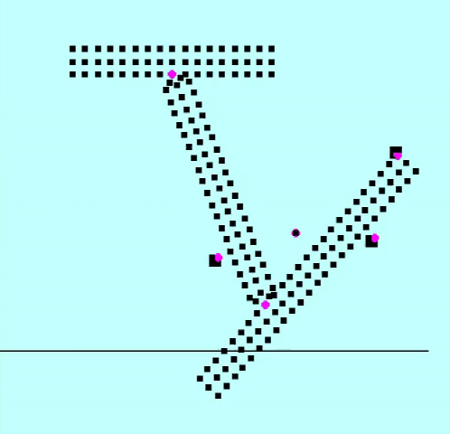
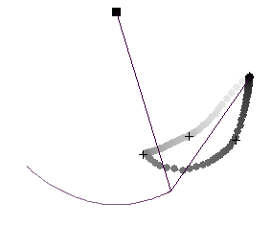
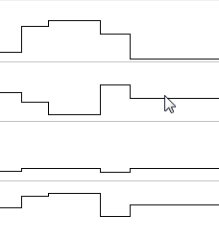
Co-articulation strategy to maintain 4 commands but AIM BEYOND the intermediate targets so that still at high velocity when approaching the target. Issue λ commands for target C BEFORE reaching B
Aim beyond target
A-B B-C C-D D-A
Anticipate target C here
A
A
B
+
3.5s
C
B
+
D
C
+
+
D
Del
Pec
Tri
Bi
Anticipate target A here

Slide 22
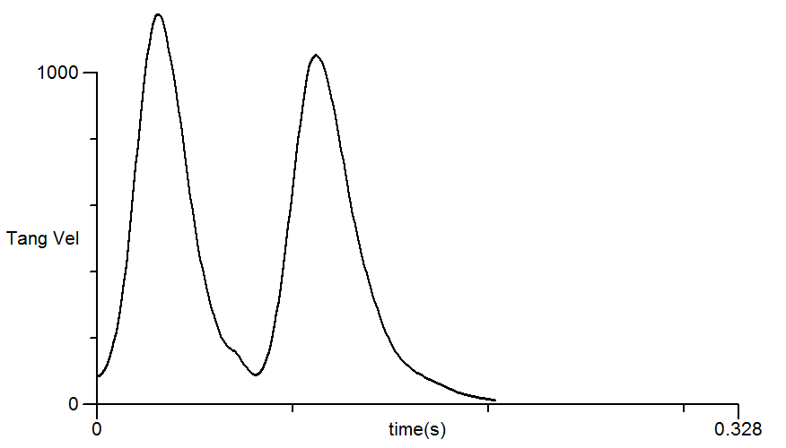
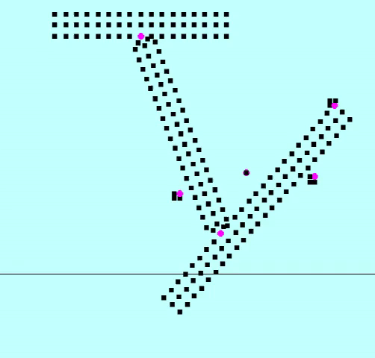
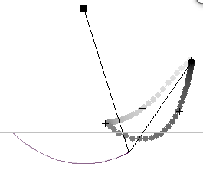
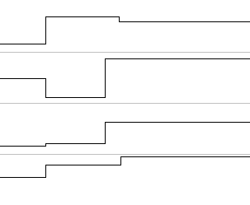
Co-articulation strategy to reduce to 2 targets (C and A) but change the trajectory to pass through intermediate targets (B and D) by altering staging of the individual muscle commands
A-C C-A
A
A
B
C
D
B
5.4s
C
D
Del
Pec
Tri
Bi

Slide 23
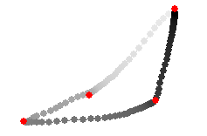



Participant hand trajectories & velocities
(Sosnik, 2004)
Results from our model
generated by timing discrete λ pulses
A
A-B B-C C-D D-A
Training Day 1
A-B B-C C-D D-A
C
B
A
B
C
D
D
5.4s
Training Day 3
A
A-B B-C C-D D-A
B
C
D
5.4s
A
Training Day 5
A-C C-A
B
C
D
5.4s

Slide 24
Summary (part I of 3)
What’s new about this
Most previous implementations of the λ model have assumed a continuous CNS control of “equilibrium trajectories”(i.e. λ values) from one equilibrium target to the next.
e.g. Perrier et al (2003) proposes “Movements are produced with constant rate shifts of the control variables from the settings of one target to those of the next target.”
We are exploring the possibility of a staged sequence of discrete λ pulses to individual muscles where the staging defines the trajectory and the accumulation of those λ pulse values defines the target.
In support of this conjecture we have shown that required timings of these discrete λ pulses loosely patterns with observed staged (phasic) EMG signals in arm movements.

Slide 25

Summary (part 2 of 3)
Important stuff we have not covered
We are NOT currently modelling spindle velocity feedback or golgi tendon feedback. We are also NOT currently modelling any delay in the feedback of length. However, as the model evolves it is likely some or all of these will be added.
Feldman suggests co-contraction of antagonist muscles is controlled to vary stiffness and hence resistance to external forces. We have observed that levels of co-contraction contribute to the planned movement trajectory although undoubtedly they contribute to stiffness too.
We have a different idea for controlling stiffness based on varying the parameter k through a separate pathway. Increasing k increases stiffness and decreases the time taken to reach equilibrium. One vague idea is that k may be controlled by varying motoneuron threshold sensitivity by controlling levels of monoaminergic neurotransmitters. Such neurotransmitters are also linked to emotions and arousal.
$$F=k∗({∆l)}^{2}$$

Slide 26
Summary (part 3)
What use is a model?
Sosnik has shown that learning efficient ( fluid, fast and accurate) transitions requires trial and error practice.
We have provided one plausible account of the planning required to generate the velocity traces observed during this learning process using our model.
It seems these more efficient transitions are not simply the result of moving the CNS (λ) commands closer together in time.
New efficient “movement elements” can be created by omitting intermediate targets and learning a new sequence of staged λ commands with a trajectory planned to pass through the intermediate target.
These new “movement elements” can take a lot of practice to learn. i.e. not a superposition process that occurs naturally from increasing rate of articulation.
Perhaps once learnt they can be added to the basic movement repertoire of the maturing motor system.
All of this conjecture should apply to tongue movements as well as arm movements.

Slide 27

Thank you.

